Slide 1
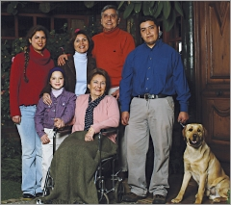
La familia

Slide 2
¡Vamos a aprender de la familia!
We will be learning more about family vocabulary and adjectives used to describe people.
Complete the following activities working at your own pace.
For the listening activities there is a written transcript. Please only read the transcript if you feel you need to.
At the end of the activity, you will have a chance to talk about your own family or a famous family you choose.

Slide 3
Click play on the following video to watch the Expresavisión video. Fill out the worksheet to go along with the video as you watch. You may watch it as many times as you need.
Click here if you need to see the written transcript while watching the video.

Slide 4
Expresavisión Transcript
Hola. Me llamo Elena y vivo en Santiago. Te presento a mi familia: mi abuela, mis padres, mi madre, mi padre, Clara, mi hermana mayor, el hermano de mi madre, mi tío Carlos, el hijo de mi tío Carlos, mi primo Mauricio. Somos siete.

Slide 5
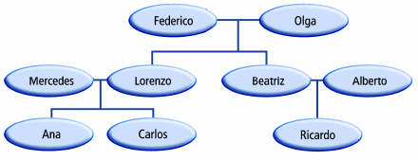
Look at the following family tree. Listen to the 8 statements and write whether they are cierto o falso. You may listen to the track as many times as you need.
Click here if you need to view the written transcript.

Slide 6
Family Tree Transcript
1. Beatriz es la hija de Federico y Olga.
2. Ricardo es el nieto de Alberto.
3. Lorenzo y Mercedes son los padres de Ana.
4. Beatriz es la tía de Carlos.
5. Olga es la madre de Ana.
6. Ana es la sobrina de Ricardo.
7. Mercedes es la abuela de Ricardo.
8. Ana es la hermana de Carlos.

Slide 7
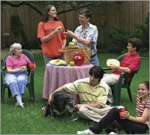
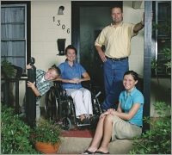
Listen to the following sentences. Then, based on the photos, decide whether each sentence refers to Carolina's family or Marta's family.
Click here if you need to view the written transcript.
la familia de Carolina
la familia de Marta

Slide 8
Listen to the following sentences. Then, based on the photos, decide whether each sentence refers to Carolina's family or Marta's family.
Su hermano tiene el pelo corto y rubio.
Su hermano es travieso.
Tiene hermanos mayores.
Su hermana mayor tiene el pelo largo.
Su abuela vive con ellos.
Su madre está en la silla de ruedas.
Su padre usa lentes.
Su familia tiene un perro.
la familia de Carolina
la familia de Marta

Slide 9
Practice with Adjectives
Read the following and match the person or animal being described.
1.En mi familia somos seis personas y un perro.
2.Mi tía tiene el pelo negro y corto.
3.El gato gordo se llama Fito.
4.Mi profesor usa lentes.
5.Mi sobrino tiene los ojos azules.
6.Mi prima tiene el pelo largo y castaño.
a.
c.
b.
d.
e.
f.
g.
h.
i.

Slide 10
A ti te toca…
Now it’s your turn! Create a powerpoint slide or keynote slide of your family tree or a famous family tree. Include at least 5 people. Be sure to save as you go!!!!!!
Once you have your family tree complete, write one sentence about each person on the tree describing them. Be sure to make your adjectives agree.
Once your tree is complete, be sure it is saved and print it out to turn it in.

Slide 11
Un poco más…
If you have finished all of you work here are a few more family terms to challenge you a little more!
el (la) ahijado(a)
el (la) bisabuelo(a)
el (la) biznieto(a)
el (la) cuñado(a)
el (la) hijastro(a)
godson, goddaughter
great-grandfather/
great-grandmother
great-grandson/
great-granddaughter
brother-in-law/ sister-in-law
stepson/ stepdaughter

Slide 12
Un poco más…
If you have finished all of you work here are a few more family terms to challenge you a little more!
la madrina
la madrastra
la nuera
el padrino
el padrastro
el (la) suegro(a)
el yerno
godmother
stepmother
daughter-in-law
godfather
stepfather
father-in-law/ mother-in-law
son-in-law

